Slide 1
TITLE : IOT Based Wireless Smart Board
Under the guidance of
Department of ISE
Acharya Institute Of Technology
Project Team Members:
Batch No :- 05
Pravesh Kasaundhan (1AY15IS072)
1

Slide 2
Agenda
2
Abstract
Brief Introduction
Application
Literature Survey
Design
Requirement Specification
References

Slide 3
Abstract
3
Digital display board is a common sight today.Advertisement is going digital in recent days. The use of digital display boards at railway station, bus stands, educational institutions and public places are becoming an effective mode of communication in providing information to the people.
If the user wants to change the message it needs to be done using a computer and hence the person needs to be present at the location. Also the display board cannot be placed anywhere because of complex and delicate wiring. Digital smart board overcomes these drawbacks.

Slide 4
Introduction
4
Digital smart board is an automatic self enabled, highly reliable wireless electronic board.
The information can be text, images, audio and video.
It makes use of a mini computer, which is commonly termed as Raspberry Pi.
It aims at designing a LED Monitor based message display controlled through a laptop.

Slide 5
contd..
5
It is simple, easy to install, user-friendly system which can receive and display information in a particular manner with respect to date and time which will help the user to easily keep the track of information everyday and each time he uses the system.

Slide 6
Application
This will help in reducing human efforts and risks involved.
Using multiple screens for displaying the big size advertising
The content on the screen is made up of several images files and broad casting display information and also remotely control it.
The broadcasting information such as subways, buses and bus station, train and train station, shopping malls, schools, conference hall, road highways, colleges and hospital for displaying all useful institutional information for visitors and this application are also used in industry for displaying notices or useful information are giving to employees.

Slide 7
Literature Survey
SL NO | Title of the Paper | Journal Published | Author | Problem Addressed | Authors Approach / Method | Results
1 | GSM Based Wireless Electronic Notice Board Display | IJATIR 2016 | P. SAMPATH KUMAR, V. PRIYANKA, LAKSHMI SUREKHA, Y. HARISH REDDY | Bluetooth based system | GSM SMS based system | Remote Access
2 | Wireless Electronic Notice Board Using Raspberry Pi 3 | IJRASET 2017 | Er. G. Jalalu, Er. Polepogu Rajesh | GSM allows limited number of messages | Memory Card for Pictorial data | This helped send multiple messages.

Slide 8
contd..
SL NO | Title of the Paper | Journal Published | Author | Problem Addressed | Authors Approach / Method | Results
3 | IOT Based Web Page Controlled Digital Notice Board | IJITR 2017 | P. BHASKARA CHARY, Dr. T. SRINIVASULU | Unformatted Data | Html forms & Java Script | Multimedia data
4 | IoT based web controlled Notice board | IRJET 2018 | Divyashree M, Harinag Prasad S, Sandeep G T, Bhavya S N, Poornima S | Static Display using older system | Scheduling with RaspberryPi | Dynamic scheduling of multimedia messages

Slide 9
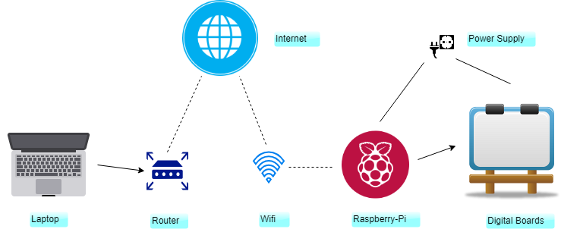
DESIGN
9

Slide 10
Requirement Specification
10
Hardware Requirements:
Laptop
Raspberry Pi
LCD Screen
Routers
WIFI Adapter
Speakers

Slide 11
contd..
Software Requirements:
Windows
Python
Dataplicity
Raspbian
11

Slide 12
References
12
Bhumi Merai, Rohit Jain, Ruby Mishra, "Smart Notice Board ", International Journal of Advanced Research in Computer and Communication Engineering , Vol. 4, Issue 4, April 2015
Vinod B. Jadhav1, Tejas S. Nagwanshi, Yogesh P. Patil , Deepak R. Patil,” Digital Notice Board Using Raspberry PI ”,International Research Journal of Engineering and Technology (IRJET) Volume: 03 Issue: 05 | May-2016
P. BHASKARA CHARY ,Dr. T. SRINIVASULU , " An IOT Based Web Page Controlled Digital Notice Board ", (IJITR) INTERNATIONAL JOURNAL OF INNOVATIVE TECHNOLOGY AND RESEARCH Volume No.5, Issue No.5, August - September 2017, 7224-7225.

Slide 13
contd..
Visit www.python.org for details on python programming.
Visit www.raspberrypi.org for details on Raspberry Pi.
Visit www.raspbian.org for details on Raspbian OS.
Visit www.dataplicity.com for details on Dataplicity.

Slide 14
14
Any Questions?

Slide 15


